Slide 1

FY 2020 Budget PRESENTATION
May 13, 2019

Slide 2

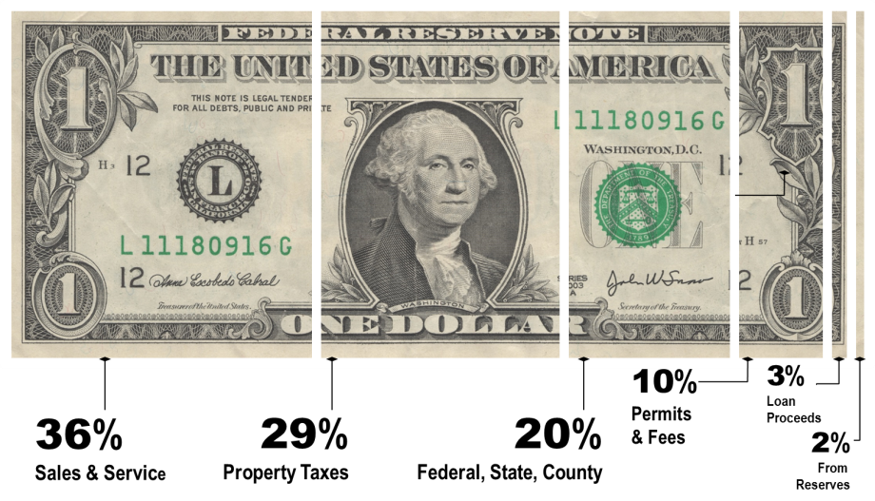
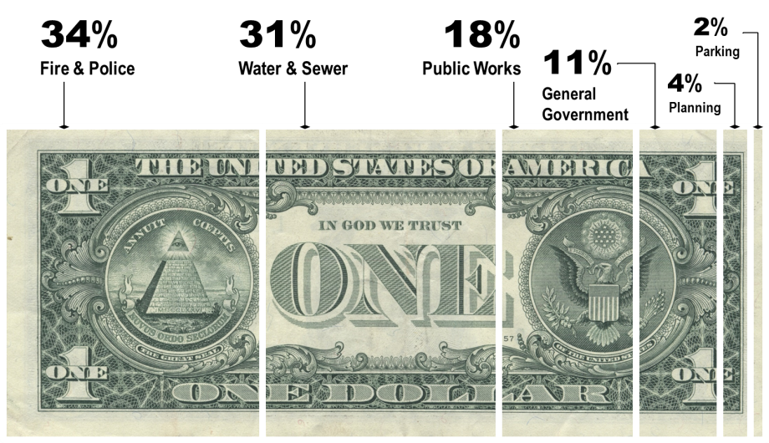
General Fund Budget
$8,652,871
Utility Fund Budget
$4,286,939
Town of Beaufort
2019-2020 Budget in Brief
Where the Money’s From
The FY 2020 budget for the Town of Beaufort, less transfers, is $12,428,810. The General Fund is balanced using the current 41.35-cent property tax rate and cash reserves of $260,000. The Utility Fund is balanced using current water and sewer rates.
However, the following critical issues arise when looking at future year financial projections.
1
  Shortfall in General Fund Requires Tax Increases in FY 2021 and FY 2023
2
  Funding for Utility Line & Street Combined Improvements Runs Out
3
  No Funding Available for Employee Compensation Market Adjustment
4
  Five Year Financial Plan Excludes or Delays Many Important Items
Where the Money Goes
as Recommended May 13, 2019

Slide 3








Guiding Themes
Strategic Budget Items for 2019-2020
Culture
Boardwalk / Bulkhead Improvements
Finalize engineering and construction documents and reapply for grant funding.
Nurture thriving families,
create excellent educational
opportunities, and cultivate
a caring coastal community
Leadership
Engage, identify goals, develop plans and take action
Environment
Infrastructure
Culture
Economic Development
Leadership
Cedar Street Park
Receive property from NC DOT, prepare construction documents, and build.
Cedar Street Utility Line Improvements
Replace utility lines
in conjunction with
NC DOT stormwater project.
Pedestrian Improvements
Improve safe access to
Randolph Johnson Park, Beaufort Middle School, Carteret County Library,
and on west 100 block Turner Street.
Economic
Development
Stormwater Improvements Program
Prioritize projects,
develop program and budget,
and prepare revised fee schedule.
Support visitor and maritime
sectors, expand marine
sciences, and foster entrepreneurship
Environment
Protect and enhance
the coastal environment; prepare for natural disasters and climate change
Street Improvements
Resurface nearly 6 miles of streets
for which underlying utilities
are in good condition.
Infrastructure
Secure our future
by maintaining
Town roads, buildings,
parks, waterways, and utilities
Utility Line & Street Improvements Combined Program
Engineer 3-block section of combined utility
and street improvements, bid out project,
and award construction contract.
Want More Info?
PAGES
4-9
To learn more about the budget, please visit www.beaufortnc.org

Slide 4

Factors Influencing the Budget
County Property Revaluation Delayed
Dedicated Funding for Infrastructure
Infrastructure Inventory and Analysis
Retirement System Contribution
Employee Compensation Market Analysis
PAGES
9-11

Slide 5
Financial Policy Considerations
Keep cash reserves in General and Utility Funds
at defined levels.
Keep water and sewer
rates at proper levels for Utility Fund to be
self-supporting.
Ensure debt service does not exceed debt limits as defined for each fund.
PAGES
19-20, 86-87

Slide 6
FY 2020 Budget Informs the Five Year Financial Plan
PAGE
154

Slide 7
Critical Issue 1
Critical Issue 1
  Shortfall in General Fund Requires Tax Increases in FY 2021 and FY 2023
PAGE
161

Slide 8
Critical Issue 2
Critical Issue 2
  Funding for Utility Line & Street Combined Improvements Runs Out
At spending levels shown, it will take 40+ years to complete
Utility Line & Street Improvements Combined Program.
PAGE
156

Slide 9
Critical Issue 3
Critical Issue 3
  No Funding Available for Employee Compensation Market Adjustment
To compete with coastal NC towns of similar size and meet State employee minimum wage requires adjusting employee compensation:
General Fund - $353,000 increase
  78% of cost in Fire & Police; 12% in Public Works
  4.38 cent tax rate equivalent in FY 2020
Utility Fund - $27,000 increase
  revenues over expenditures beginning in FY 2021
PAGE
11

Slide 10
Critical Issue 4
Critical Issue 4
  Five Year Financial Plan Excludes or Delays Many Important Items
Personnel Positions
  Deputy Town Clerk - $52,400 in FY 2021
  Park Maintenance Tech - $42,000 in FY 2021
  3 Firefighters - $154,000 in FY 2020
Capital Outlay
  Unified Development Ord - $150,000 in FY 2020
  Fire Training Tower - $60,000 in FY 2023
  Police vehicle – $46,000 in FY 2021
  2 Public Works trucks – delayed two years each
PAGE
14

Slide 11

Budget Work Session
Mon, May 20 – 4 PM
Town Hall Conference Room

